Slide 1
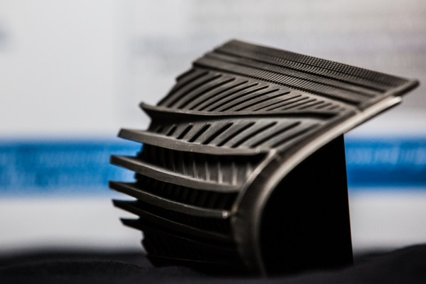
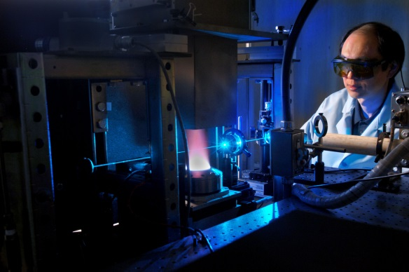
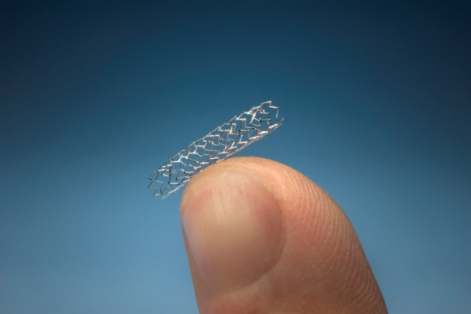
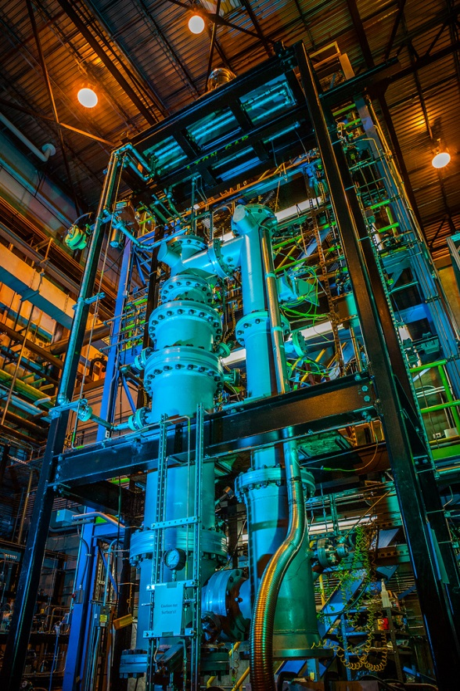
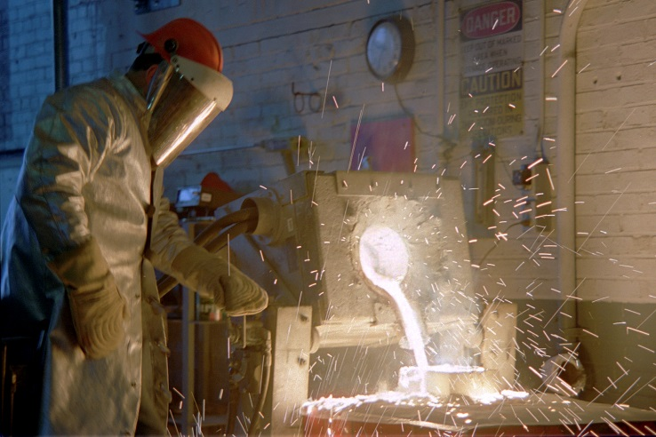
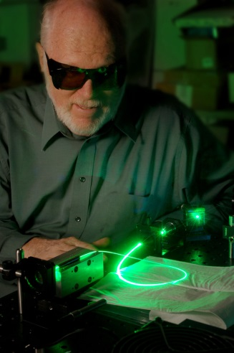
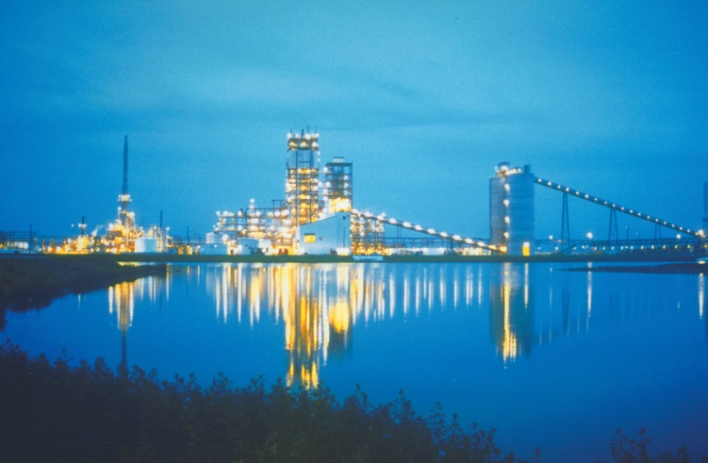
Multiphase Flow R&D at NETL
Madhava Syamlal
Office of Research and Development
August 12, 2015

Slide 2
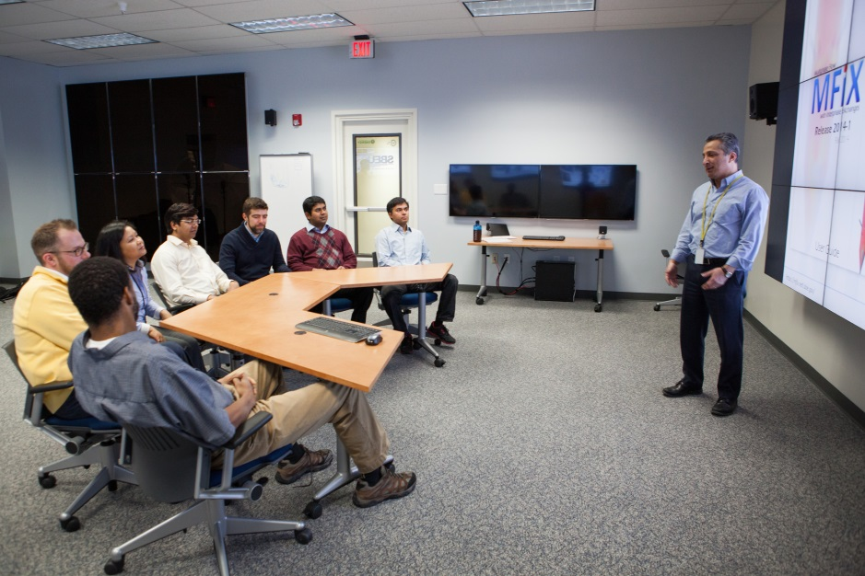

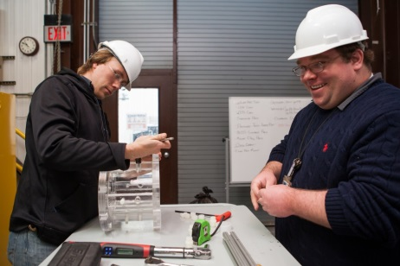
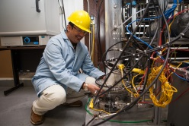

Contributors
S. Benyahia
G. Breault
J. Carney
A. Choudhary
S. Deb
J. Dietiker
R. Garg
A. Gel
B. Gopalan
C. Guenther
D. Huckaby
T. Jordan
H. Kim
A. Konan
T. Li
M. Massoudi
M. Meredith
D. Miller
J. Musser
P. Nicoletti
R. Panday
S. Rabha
W. Rogers
P. Saha
F. Shaffer
M. Shahnam
R. Singh
J. Spenik
M. Syamlal
J. Tucker
D. Van Essendelft
V. Verma
J. Weber
Collaborators
J. De Wilde (UCL)
C. Roy (VT)
X. Sun (PNNL)
S. Sundaresan (Princeton)
J. Torres (MIT)

Slide 3
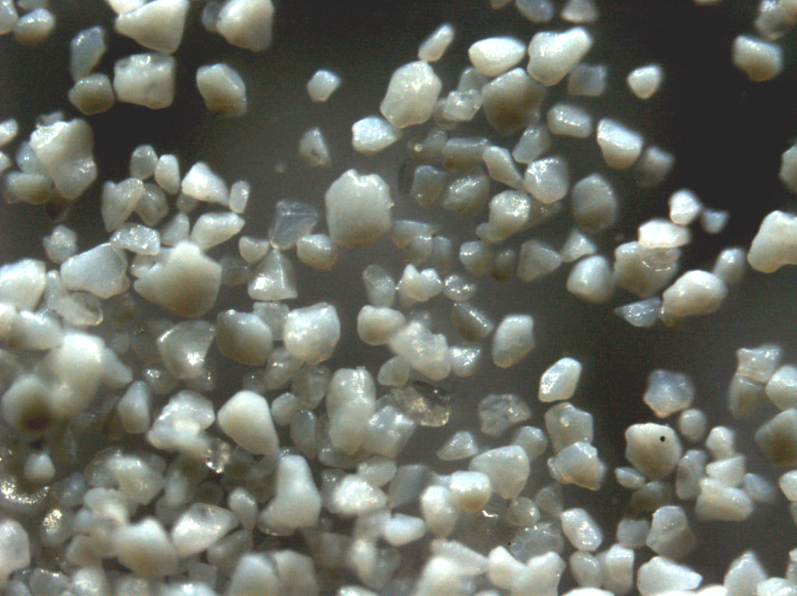
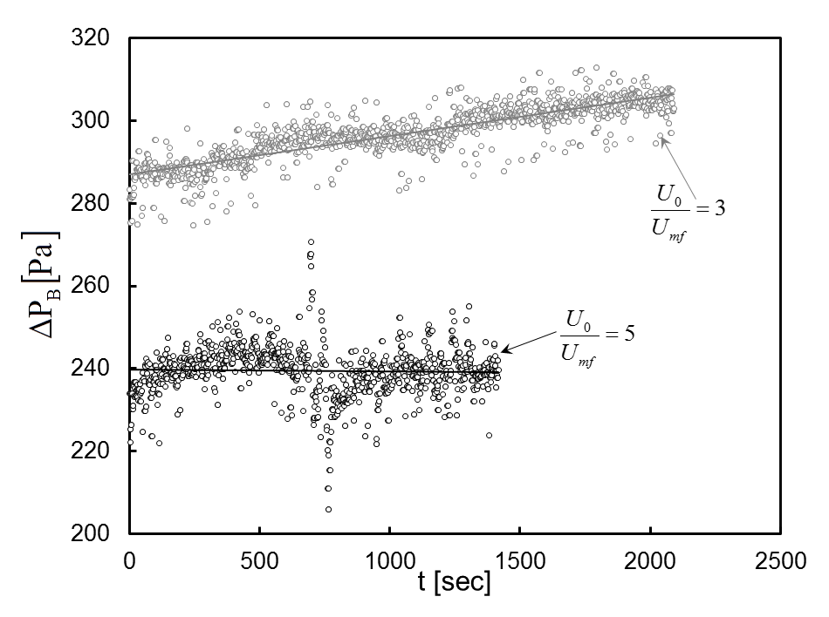
Lab-scale experiments for validating CFD models of carbon capture reactors
Sorbent 32D
Fixed bed
Bubbling bed
S. Rabha, R. Panday, G. Breault , B. Gopalan, J. Tucker, W. Rogers, "Carbon capture using amine-impregnated mesoporous sorbent in fixed and bubbling beds", Proceedings of the International Mechanical Engineering Congress & Exposition (ASME 15), November 13-19, 2015, Houston, Texas, USA.
Notes:
Carbon capturing phenomenon from a flue gas mixture (N₂:CO₂ = 80:20) using amine- impregnated mesoporous sorbent (NETL-32D) was investigated in a small scale batch unit at ambient temperature and pressure. The variation of local bed temperature at different axial location of the bed, pressure drop across the bed, carbon breakthrough and adsorption capacity as a function of moisture content, bed heights and flow rates under both fixed bed and bubbling bed was reported. Further, an interconnections among the different parameters like pressure drop, temperature and carbon breakthrough were analyzed based on the time scale, which also depends on the flow rate, moisture present in the gas stream. The present findings will offer a valuable database for the CFD model validation of small scale carbon capture unit.
Investigate the temperature and pressure variation within the sorbent bed and CO2 breakthrough under different operating conditions for CFD model validation.

Slide 4
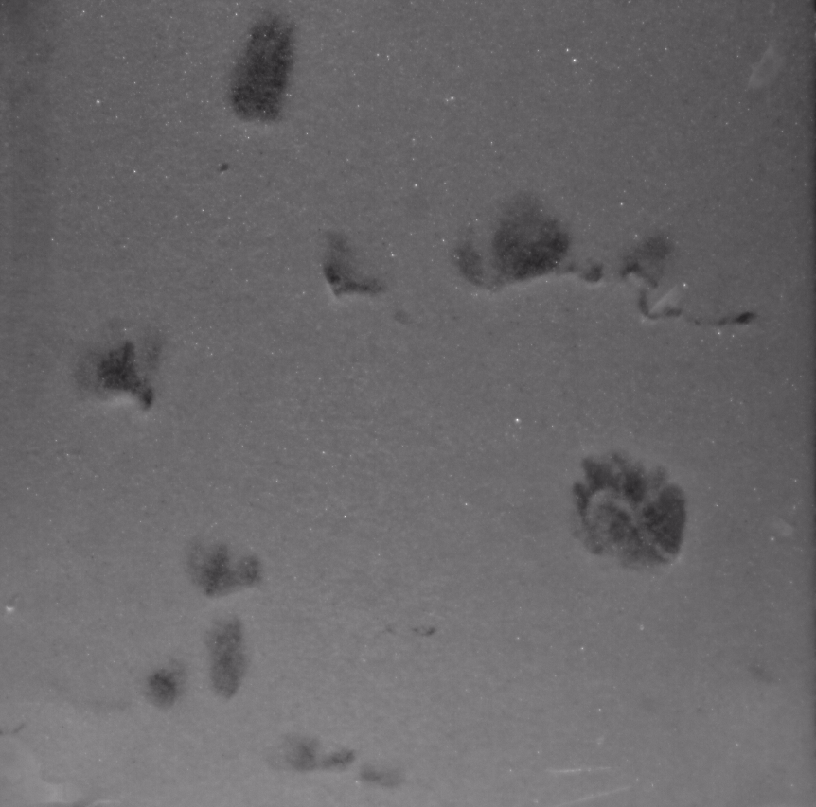
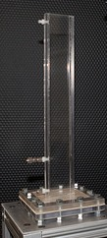
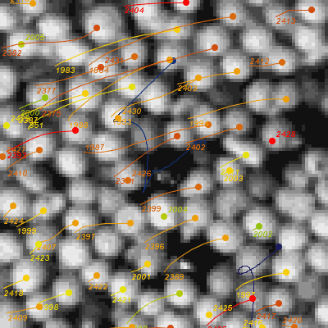
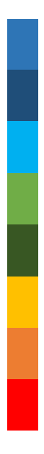
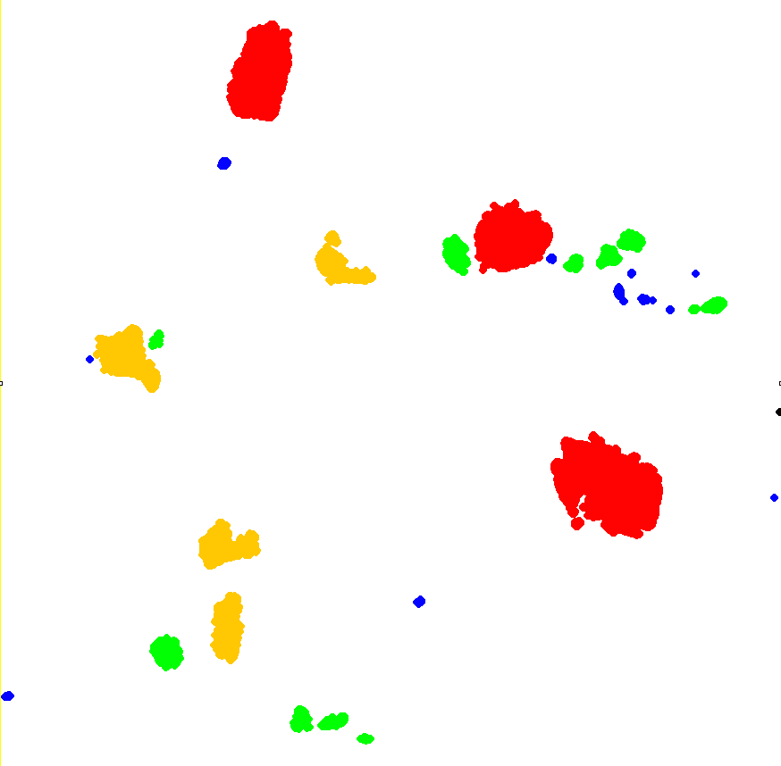
Micro-fluidized-bed experiments for validating MFIX-DEM
33 million
80 μm glass beads
5 million
148 µm FCC particles
Depth = 3mm
Width = 50 mm
0.0003
Raw data
After
thresholding
0.45
Vertical Particle Velocity
Bubble dia and velocity
High speed PIV Analysis
Notes:
The present work focus on the qualitative and quantitative analysis of particle and bubbles in a micro fluidized bed. The main objective of this work is to provide data for one to one comparison of MFiX -DEM code.
The parameters to be studied are particle properties, particle size, polydispersity. The quantitative analysis of particles ( particle velocity, granular temperature, particle tracks) along with bubble dynamics will be studied. The right side of the slide shows an example of particle tracking of 148 micron FCC particles at 5Umf. The average particle velocity in the vertical direction is also shown. Left side figure on the slide shows the procedure of bubble tracking from the raw images and finally quantitate data.

Slide 5
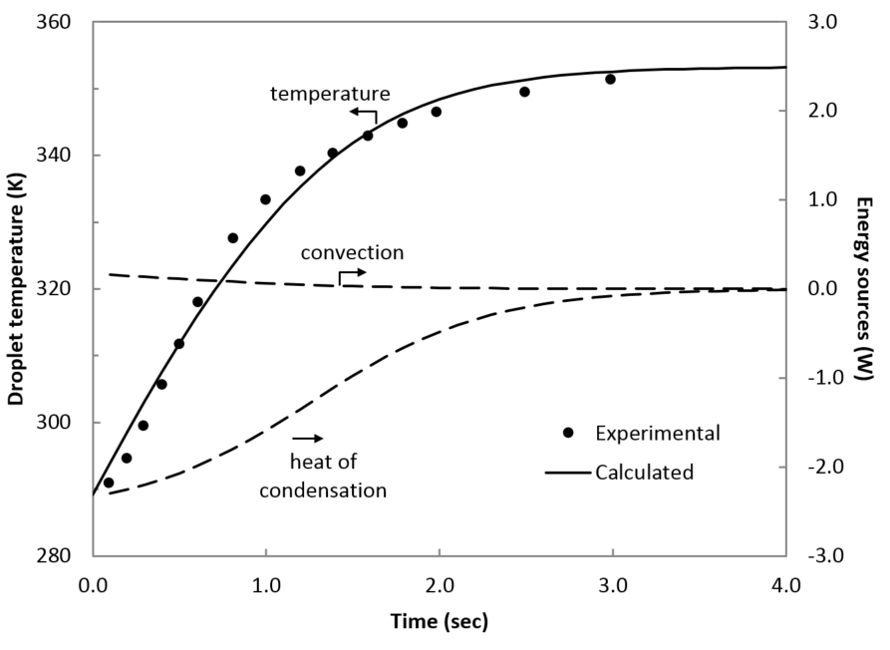
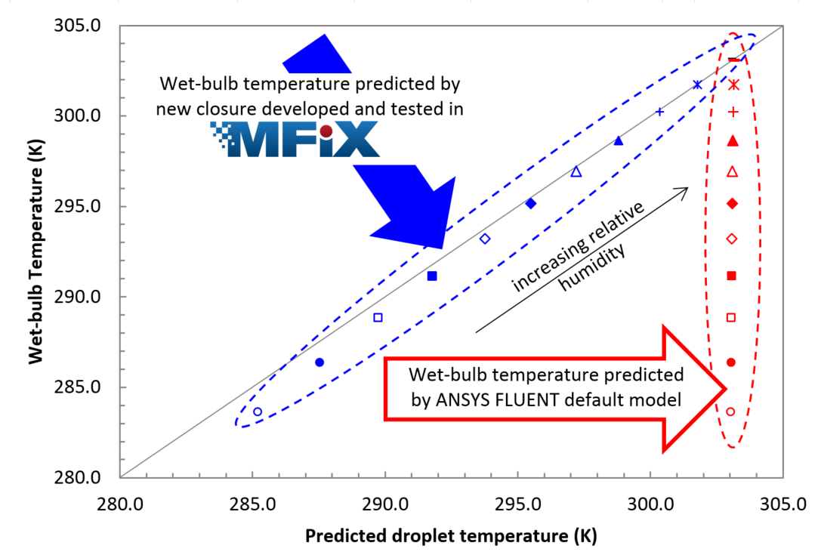

New constitutive equation for heat transfer caused by mass transfer
h_{gH2O}(T_{m})
h_{gH2O}(T_{m})
Droplet
Gas
Barracuda® now uses this as the default model as it is “physically more accurate” and “numerically more stable.”
Musser, J., Syamlal, M., Shahnam, M., Huckaby, D., “Constitutive equation for heat transfer caused by mass transfer”, Chemical Engineering Science, Volume 123, 17, February 2015, pp 436-443.
Notes:
Motivated by an observation from a chemical looping simulation: Previous enthalpy split between carrier phase and gas phase caused one phase feeling endothermic reaction and the other phase, exothermic, where as both should have been slightly endothermic.
Several multiphase flow models from MFIX have been transferred to commercial CFD software over the years (mathematical equations for calculating drag, heat transfer, stress etc.). For example, the leading commercial CFD software ANSYS/FLUENT uses many models from MFIX. Here is a recent example of this type of ongoing tech transfer.
In February 2015 NETL researchers published a paper that proposed a general equation for the energy transfer accompanying mass transfer between phases because of physical or chemical changes (e.g., sorbent particles absorbing CO2). They had found that the models proposed in the literature are deficient. A new model was developed and tested within MFIX. The top right hand side plot shows that the new model captures very well the temperature change of water droplets in air (“wet bulb” effect), where as the model in ANSYS/FLUENT does a poor job. (Wet bulb cooling is not a difficult phenomena to model, and is not point of this comparison. Wet bulb cooling is used here only to show that an existing model in a widely used software is deficient).
By April 2015 the new model was already incorporated into the latest version of the commercial software Barracuda. Furthermore, it was made the “default model” because the new model is “physically more accurate” and “numerically more stable” per Barracuda release notes.
Multiphase computational fluid dynamics (CFD) models are widely used for describing dispersed multiphase flows in natural and engineered systems, and is used for modeling FE devices such as gasifiers, chemical looping reactors, and CO2 capture devices.

Slide 6
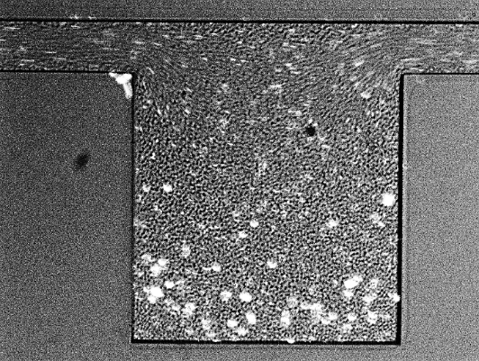
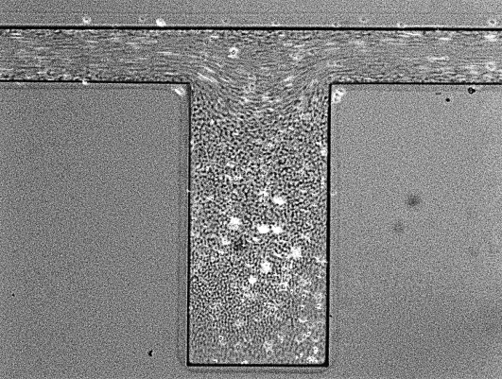
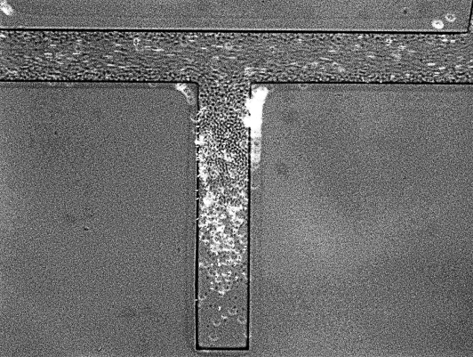
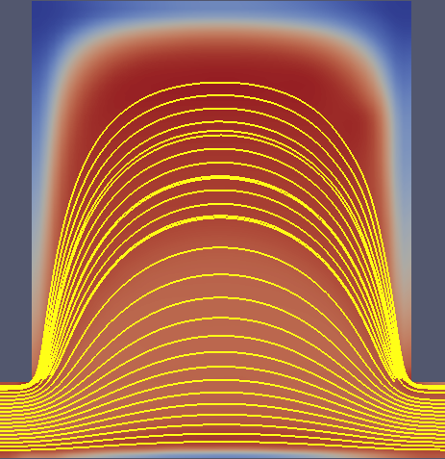
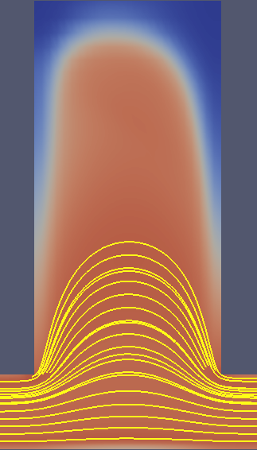
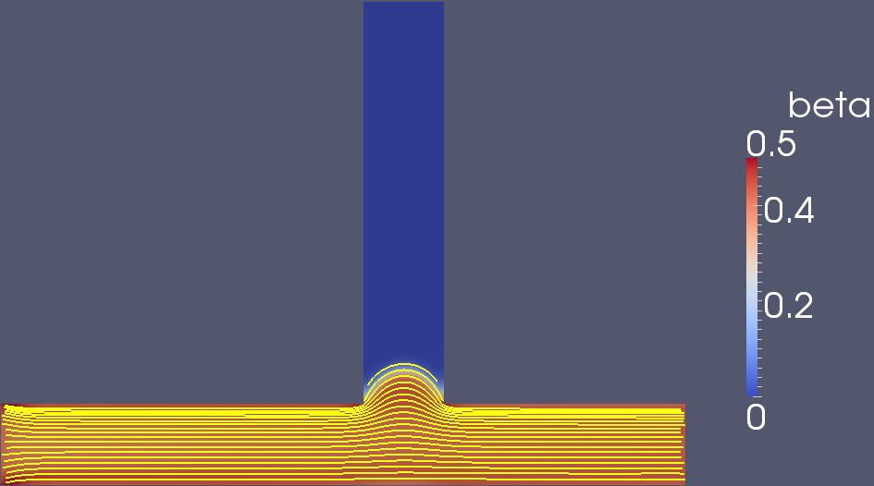
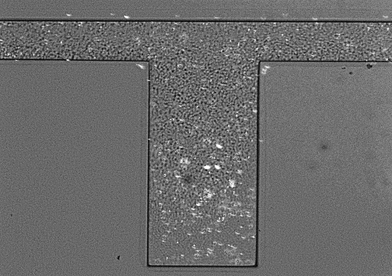
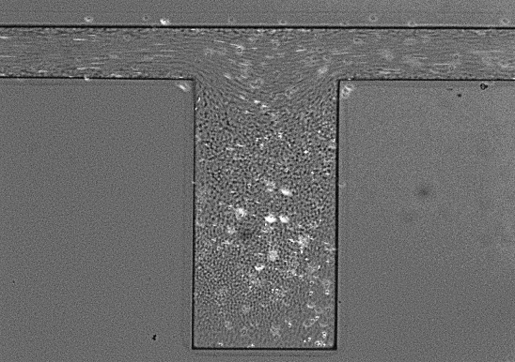
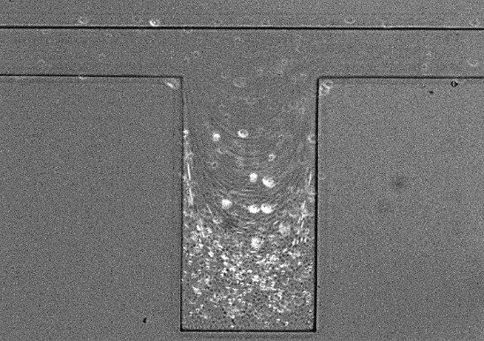
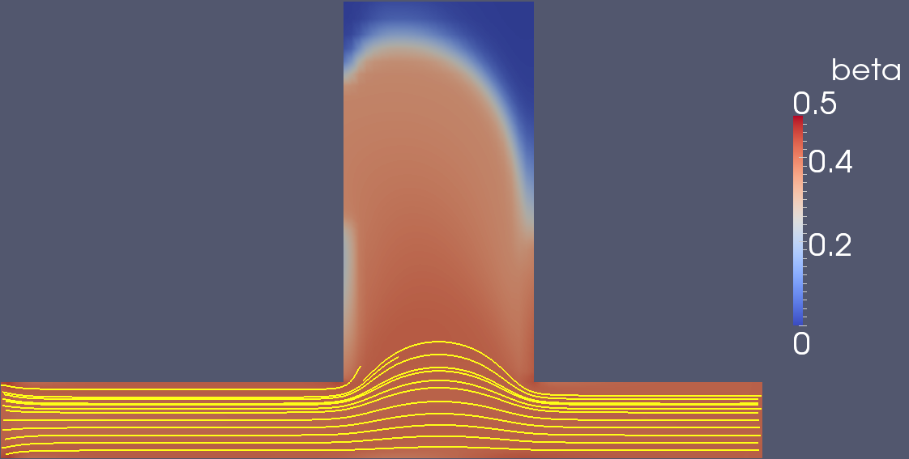
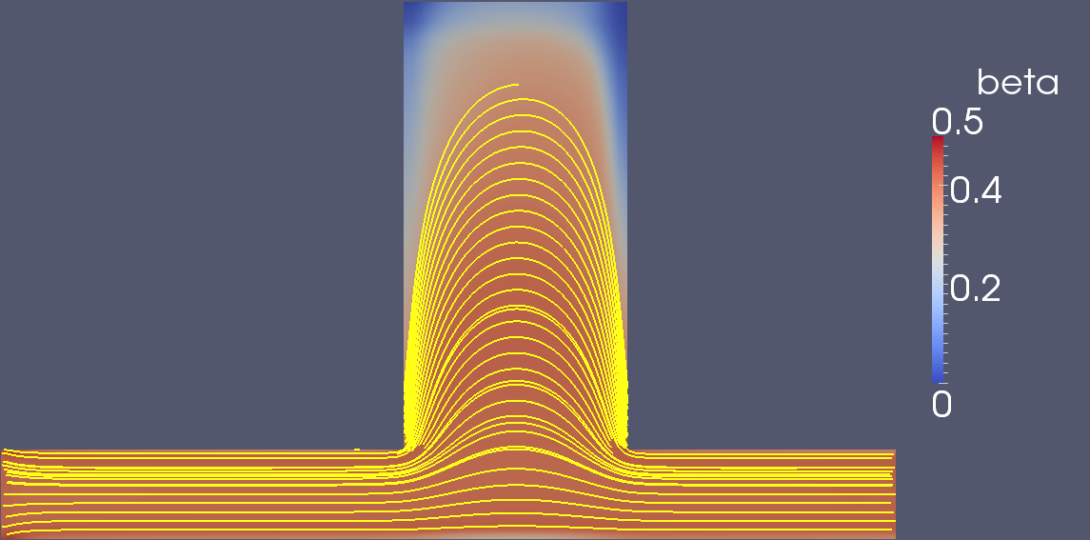
Blood flow in a channel with crevices
Zhao et al. (2008) Experiment
RBC concentration and streamlines
ACCUMULATION
REGION
50 μm
Re = 0.2
FLOW
50 μm
Re=0.02
Re=0.2
Re=2.0
W. T. Wu, F. Yang, J. F. Antaki, N. Aubry, and M. Massoudi . "Study of blood flow in several benchmark micro-channels using a two-fluid approach,“ International Journal of Engineering Science (2015). http://dx.doi.org/10.1016/j.ijengsci.2015.06.004
Notes:
It is known that in a vessel whose characteristic dimension (e.g., its diameter) is in the range of 20 to 500 microns, blood behaves as a non-Newtonian fluid, exhibiting complex phenomena, such as shear-thinning, stress relaxation, and also multi-component behaviors, such as the Fahraeus effect, plasma-skimming, etc. For describing these non-Newtonian and multi-component characteristics of blood, using the framework of mixture theory, a two-fluid model is applied, where the plasma is treated as a Newtonian fluid and the red blood cells (RBCs) are treated as shear-thinning fluid. A computational fluid dynamic (CFD) simulation incorporating the constitutive model was implemented using OpenFOAM® in which benchmark problems including a sudden expansion and various driven slots and crevices were studied numerically. The numerical results exhibited good agreement with the experimental observations with respect to both the velocity field and the volume fraction distribution of RBCs.
The crevice simulation is motivated by the fact that most blood wetted devices with seams and joints are predisposed to thrombus deposition.
The RBCs are assumed to behave as a viscoelastic shear-thinning fluid, whose viscosity is also a function of the volume fraction. The material parameters, $μ_{0}$, $μ_{∞}$ and $k$ are assumed to depend on $φ$ in the form of polynomial function and $β_{20}$ is a constant. At low shear rates, the RBCs aggregate and form rod-shaped stacks due to the fibrinogen and large globulins, which increases the blood apparent viscosity. For the interaction force between the two components, we only consider terms which would correspond to the Stokes drag force and Saffman's shear- lift force. (See[63, 64].)
$$f_{I}=\frac{9μ_{f}}{2a^{2}}f\left(φ\right)\left(v_{rbc}−v_{f}\right)+\frac{3(6.46){\left(ρ_{f}μ_{f}\right)}^{1/2}}{4πa}φ{\left(2tr{D_{f}}^{2}\right)}^{−1/4}D_{f}\left(v_{rbc}−v_{f}\right)$$
(10)
where $a$ is the diameter of RBCs, here assumed as 8$μm$, and $f\left(φ\right)=\exp\left(2.68φ\right)+φ^{0.43}$ is the drag model (hindrance function) measured by Rusche and Issa [65].
For all the cases studied in this paper, we use the following values for the material properties: $μ_{f}=0.96cP$, $ρ_{f}=1027kg/m^{3}$ and $ρ_{rbc}=1093kg/m^{3}$. The boundary conditions are listed in Table 1 (For details see[67]). The total number of material parameters or constants associated with the constitutive relations is 10; these are $μ_{f},λ_{f}, ρ_{f}, ρ_{rbc},μ_{0}, μ_{∞},a, k,f\left(φ\right), β_{20},$.
W.-T. Wu, N. Aubry, M. Massoudi, J. Kim, and J. F. Antaki. A numerical study of blood flow using mixture theory. International Journal of Engineering Science. Vol. 76 (2014), pp. 56-72.
Zhao R. et al. (2008) Micro-flow visualization of red blood cell-enhanced platelet concentration at sudden expansion. Annals of biomedical engineering, 36(7), 1130-1141.

Slide 7
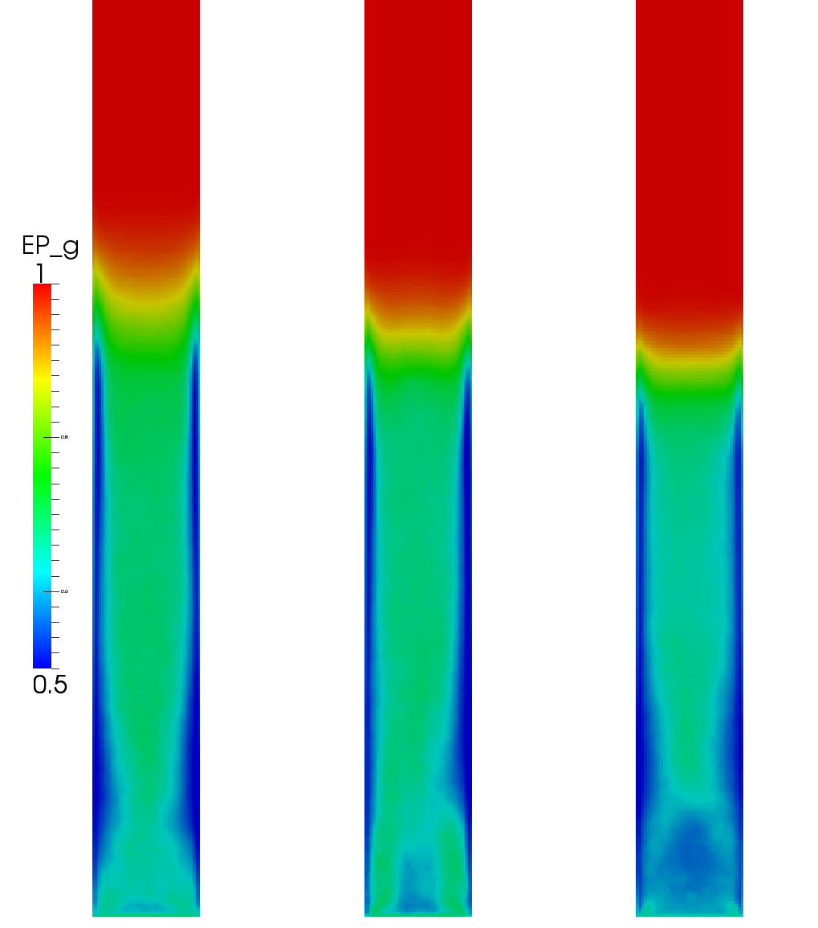
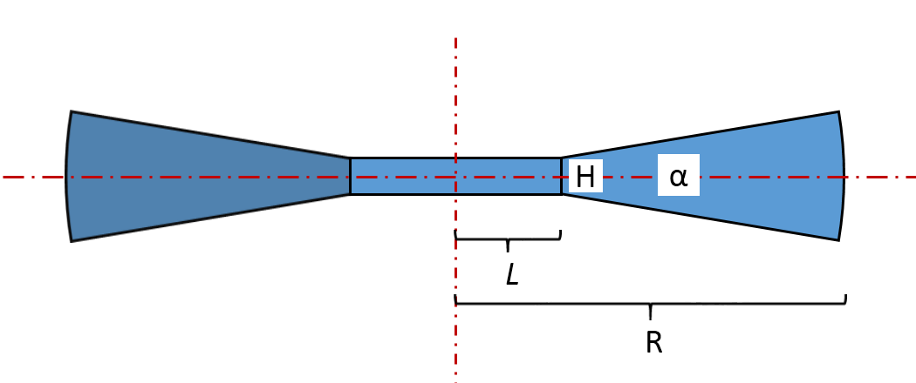
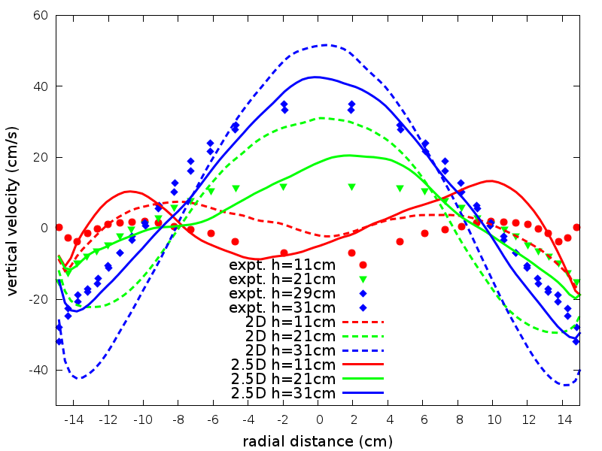
2.5D model for cylindrical fluidized beds
2.5 D computational domain
Voidage
2.5D predicts bed height in better agreement with 3D
2D
2.5D
3D
2.5D predicts solids flow near the wall in better agreement with experimental data
T. Li, S. Benyahia, J. Dietiker, J. Musser, and X. Sun, A 2.5D computational method to simulate cylindrical fluidized beds, Chemical Engineering Science, 2015, 123, 236-246.
T. Li, Validation of a 2.5D CFD model for cylindrical gas-solids fluidized beds, 2015, under preparation
Notes:
In this paper, the limitations of axisymmetric and Cartesian two-dimensional (2D) simulations of cylindrical gas-solid fluidized beds are discussed. A new method has been proposed to carry out pseudo-two-dimensional (2.5D) simulations of a cylindrical fluidized bed by appropriately combining the benefits of Cartesian 2D and axisymmetric assumptions. This is done by constructing a computational domain consisting of a central thin plate and two wedges. The proposed method was implemented in the open-source code MFIX and applied to the simulation of a lab-scale bubbling fluidized bed with necessary sensitivity study. After a careful grid study to ensure the numerical results are grid independent, detailed comparisons of the flow hydrodynamics were presented against axisymmetric and Cartesian 2D simulations. Furthermore, the 2.5D simulation results have been compared to the three-dimensional (3D) simulation for evaluation. This new approach yields better agreement with the 3D simulation results than with axisymmetric and Cartesian 2D simulations.
The 2.5D model recently proposed by Li et al. (Li, T., Benyahia, S., Dietiker, J., Musser, J., and Sun, X., 2015. A 2.5D computational method to simulate cylindrical fluidized beds. Chemical Engineering Science. 123, 236-246.) was validated for two cylindrical gas-solids bubbling fluidized bed systems. Different types of particles tested under various flow conditions were simulated using the traditional 2D model and the 2.5D model. Detailed comparison against the experimental measurements on solid concentration and velocity were conducted. Comparing to the traditional Cartesian 2D flow simulation, the 2.5D model yielded better agreement with the experimental data especially for the solid velocity prediction in the column wall region.

Slide 8
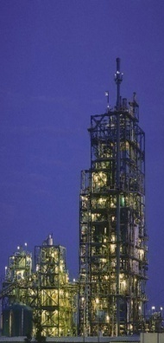


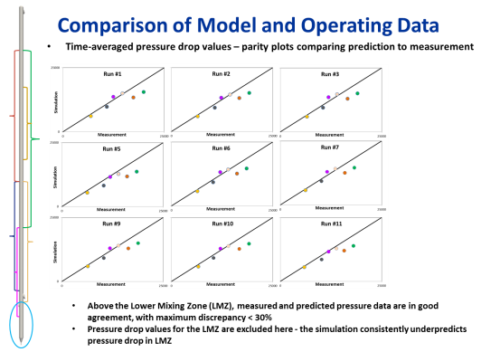
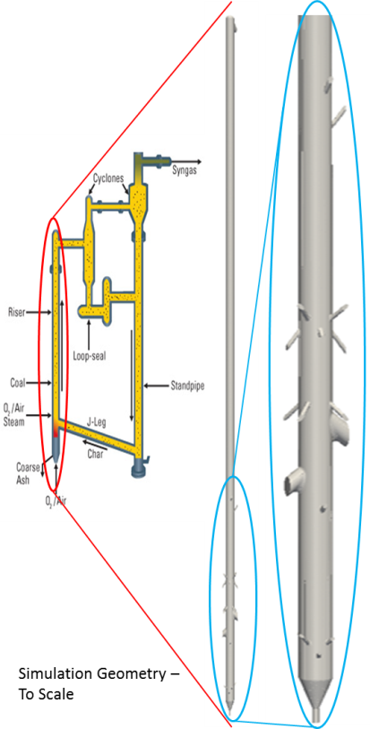
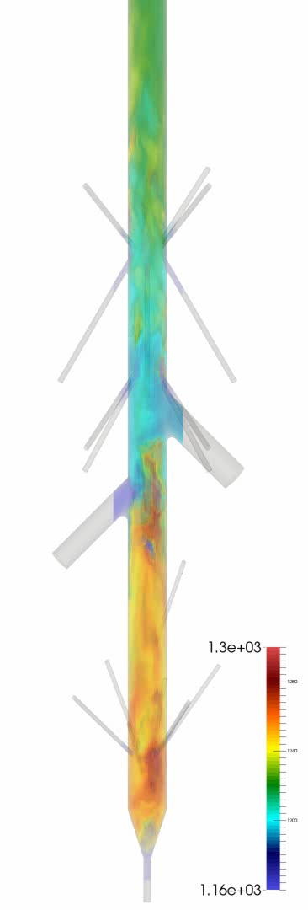
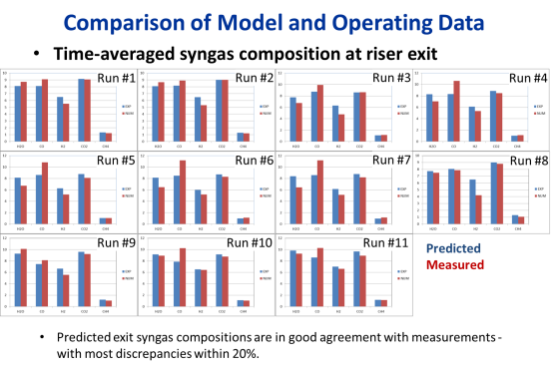
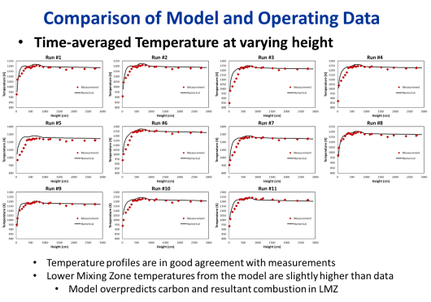
TRIG ™ Gasifier, Wilsonville, Alabama
Gas Temperature (K)
T. Li, W. Rogers, D. McCarty, J. Tennant. Computational Fluid Dynamic Simulations of a Pilot-Scale Transport Gasifier Using Mississippi Lignite Feedstock. Presented at Gasification Technologies Conference, October 26-29, 2014 Washington, DC.
Notes:
A comprehensive set of detailed multiphase computational fluid dynamic simulations of the TRIG gasifier were conducted using NETL’s MFIX code. These simulations are based on testing performed at the Power Systems Development Facility (PSDF) for the TRIGTM gasifier operating over a broad range of conditions with Mississippi Lignite feedstock. NETL has previously modeled PSDF TRIG™ gasifier performance for both bituminous and Powder River Basin coals and comparison with SCS data has been very good. This work builds on these efforts and uses enhanced MFIX capabilities and the new NETL-based supercomputing facility to create more detailed models to more accurately model TRIG™ performance. With the enhanced meshing capability for dealing with complex flow geometry, detailed feed distributions in the gasification process are fully accounted for in the model to allow investigation of their impact on gasifier performance.
The new coal chemistry enhancement to MFIX, called Carbonaceous Chemistry for Computational Modeling (C3M) leverages the kinetic models from leading coal kinetic packages to provide the detailed reaction kinetics in the gasification process for the MFIX gasifier model. Gasifier performance over a range of operating conditions has been modeled to verify the ability of the model to predict parametric behavior. Excellent agreement between model predictions and experimental measurements has been seen over a broad range of operating conditions..
Extensive simulation study of PSDF gasifier using Mississippi Lignite
Very good agreement in temperature, pressure, syngas composition
Model predicts lower mixing zone more dilute than experimental observation

Slide 9
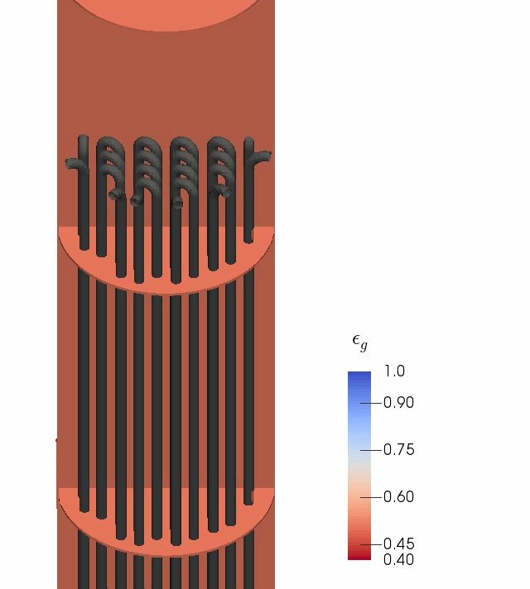
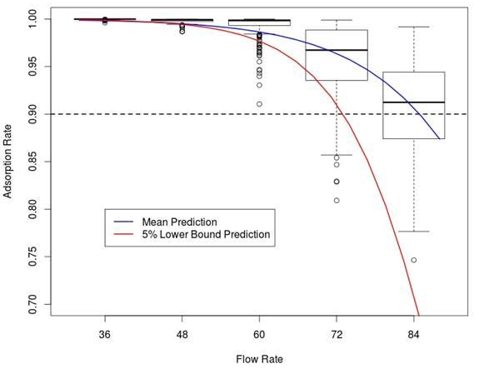

Predicting the performance of scaled-up CO₂ adsorber with quantified confidence
CO₂ Capture Efficiency
Gas Flow Rate
At what condition can we be 95% certain that the required capture will be achieved?
K. Lai, Z. Xu, W. Pan, J. Dietiker, T. Li, P. Marcy, C. Storlie, X. Sun, and S. Sundaresan , “Quantifying CFD Predictive Confidence on CO2 Capture Efficiency of 1MW Pilot-scale Solid Sorbent Adsorber with a Hierarchical Calibration and Validation Approach, CCSI Milestone Report, Oct 2014.
Notes:
1 MW scale testing at Southern Company Plant
Pilot designed for 90% capture; 2300 lb Co2/hr; Flues gas flow rate 2600 SCFM
As described in Section 5.3, a sample of 351 parameter settings from the posterior distribution of 15 model parameters has been obtained. These 351 settings then are used to produce an ensemble of MFIX model runs for the 1MW system. Of these 351, many (~100) runs fail at each flow rate. However, the successful runs from this ensemble can be used to make predictions with uncertainty for any QOI. Figure 22 provides the entire uncertainty distribution along with the posterior mean (i.e., a best guess) prediction and a 95 percent lower confidence bound for two QOIs: CO₂ adsorption rate and bed height, respectively, at a flow rate of 0.72 kg/s. While the posterior mean prediction suggests that, at a flow rate of 0.72 kg/s, this 1MW system will capture more than 95 percent of the CO₂, the lower confidence bound suggests it could result in as low as ~83 percent capture. Similar conclusions can be drawn for the bed height in Figure 22 or any other QOI, for that matter.
Figure 22 Uncertainty distribution for predictions of CO₂ adsorption rate and bed height, respectively, for a flow rate of 0.72 kg/s.
Since the DOE target for carbon capture is 90%, we next use the 1MW simulation framework with quantitative confidence to answer the following question: For this conceptual adsorber design, at what inlet gas flow rate can we be 95 percent certain to obtain 90 percent capture? The ensemble of the 1MW runs made here also can be used to answer this or similar questions. In particular, an ensemble of runs has been made at each of the flow rates: 0.48, 0.60, 0.72, and 0.84 kg/s. Figure 23 features box plots showing the resulting distributions for each flow rate. Furthermore, quantile regression can estimate the fifth percentile of the distribution (i.e., the 95 percent lower confidence bound) as a function of flow rate [9]. Because the capture rate has a range of [0,1], this QOI first is transformed to a logit scale prior to conducting the quantile regression. Then, it is transformed back to the original scale for presentation. This 95 percent lower confidence bound as a function of flow rate also is displayed in Figure 23. From this, we can conclude that at a flow rate of 0.65 kg/s may be 95 percent confident to obtain a capture fraction of, at least, 0.90. The mean, or best guess prediction, as a function of flow rate also is included for reference (the blue curve in Figure 23). The mean curve is obtained with traditional regression on the logit scale.

Slide 10
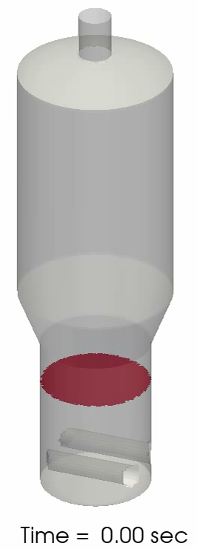
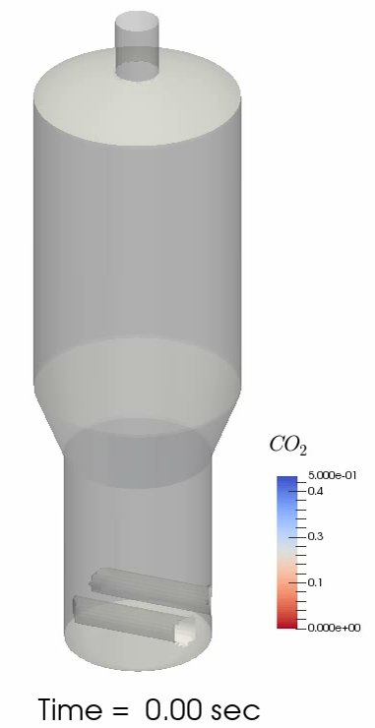
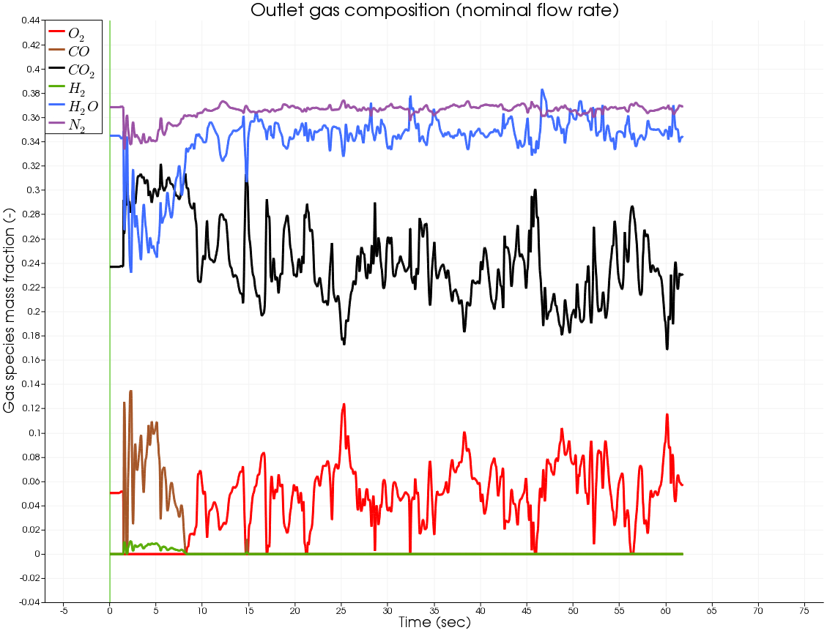
Integrated Waste Treatment Unit, Idaho
Carbon Reduction Reformer Simulations
Outlet gas composition
Iso-surface of void fraction
Iso-surface of CO₂ mass fraction
 | O₂ | CO₂ | H₂O | N₂
Exp. | 5.0% | 23.7% | 34.5% | 36.8%
MFiX | 5.4% | 23.0% | 34.9% | 36.7%
Notes:
MFIX-TFM simulation results of the Integrated Waste Treatment Facility Unit developed to process sodium-bearing waste stored at the Idaho Nuclear Technology and Engineering Treatment Center.
The void fraction isosurfaces in the fluidized bed illustrate bubble formation above the rail distributors.
The outlet gas composition matches well the experimental data.
Composition
10 gas species (Soot, O₂, CO, CO₂, CH₄, H₂, H₂O, N₂, HCN, C₂H₆)
2 solids phases: coal (C, volatile matter, moisture, ash) and Bauxite
Total of 30 transport equations (continuity, momentum, energy, species)
The kinetics are implemented with C3M
Experimental data is coming from a spreadsheet Idaho folks sent back in May. The asymmetry comes from the petcoke inlet on the right-hand-side of the unit.

Slide 11
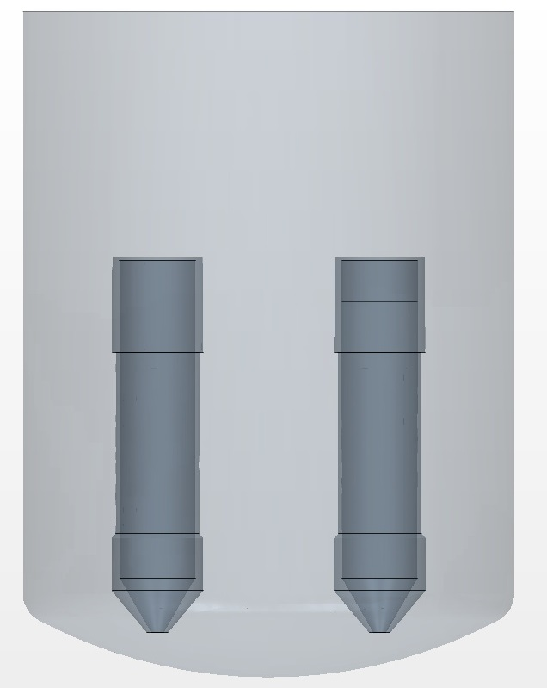
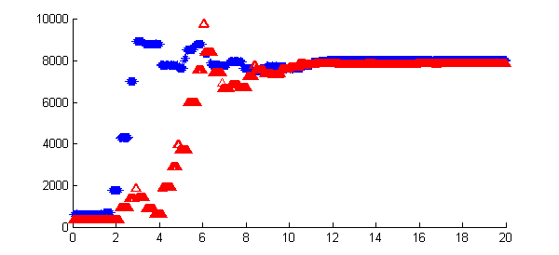

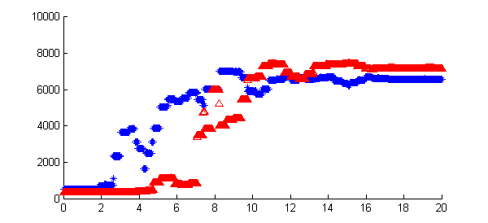
Validating single liquid assumption in modeling Pulsed Jet Mixing (PJM) Vessels
0% solids
0.99 m
Data for 0% & 0.5% solids cases in agreement
H/D = 0.87
PJM Nozzle Velocity
Conductivity (μS/cm)
Conductivity Probes for Mixing Time Measurement
H/D = 0.65
PJM Cycles
H/D = 0.62
Mixing Time
0.15 m
H/D = 0.35
EM Probes for Velocity Measurement
Bottom Probe
Conductivity (μS/cm)
H/D = 0.19
Top Probe
Central Upwash Velocity
PJM Cycles
0.04 m
0.5% glass beads
0.025 m
B. Gopalan, D. Miller, R. Garg & C. Guenther,” Experimental Investigation of Particle Loading on Miscible Fluid Blending in Pulse Jet Mixing Vessels,” Presented at GLS 12, June 28-July 1 NY (2015).
Notes:
A one fourth scale model Pulsed Jet mixing (PJM) Tank has been constructed at NETL to help in Design Verification the Pre-Treatment Facility at Hanford WA. This mixer operates by suction and discharge of the liquid inside the tank through the PJM’s continuously. The current goal is to identify the boundary of flow conditions, particle size, density and concentration for which the effect of particles on the vessel operation could be neglected or approximated by a modified liquid. To identify this Single Liquid Assumption regime we look at the variation of the velocity of the central up-wash jet and the overall mixing time (where conductivity is used as a proxy) upon addition of the solids. In the examples shown here we can see that upon addition of 0.5% of 10-80 micron Glass beads the steady state phase averaged velocity does not change in both at the PJM nozzle as well as at the central upwash region. The mixing time increases slightly from 11 to 16 PJM cycles but this is well within the allowable process variability. This data provides the proof of concept for the Single Liquid Assumption regime and more experiments will be conducted to identify the boundaries of this regime for the PJM mixing tank.
We add 2% volume of NaCl solution to the bottom which has a higher specific gravity (1.18) and conductivity than water. As the PJM operates the central up-wash lifts the heavy NaCl solution and the conductivity is the proxy for mixing the higher specific gravity liquid. As time passes the conductivity measured by the probes near the top increases. When the conductivity of the two probes match (red and blue curve join) we call that the mixing time (11 cycles for case 1 and 16 cycles for Case 2).
Case No
Solids
Simulant
1
None
2%
2
0.5% glass beads (10-80 micron)
2%

Slide 12
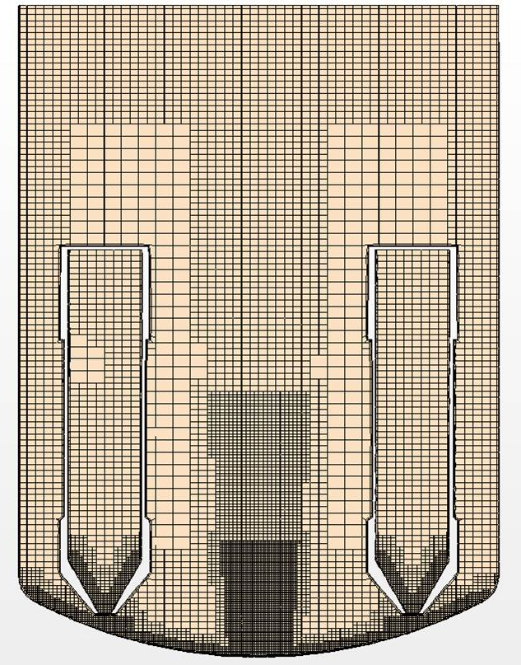
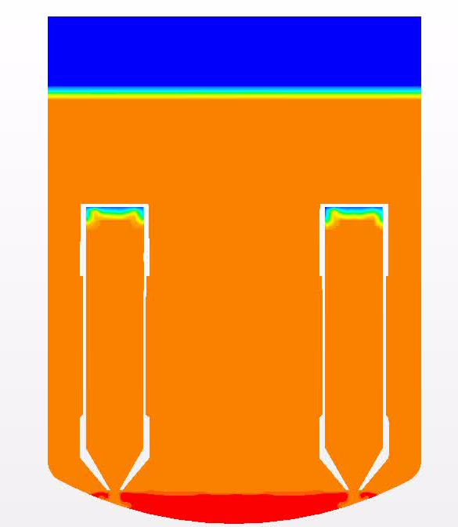
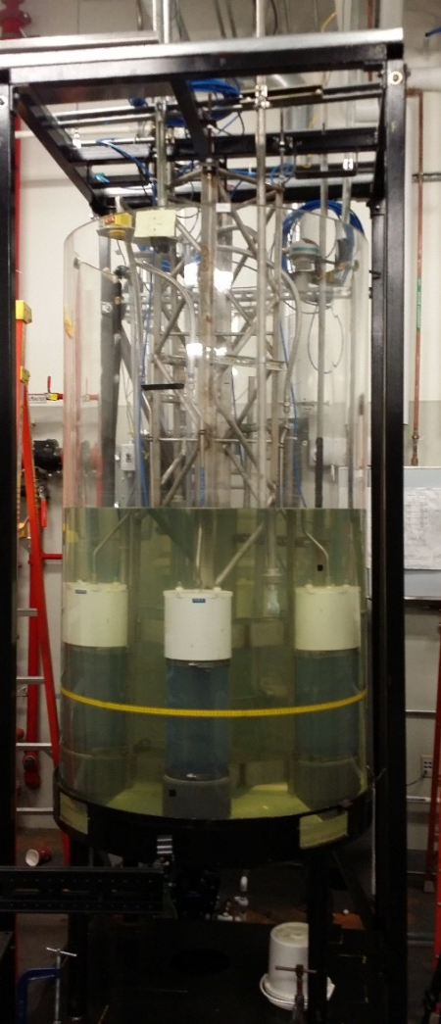

CFD modeling of single-phase PJM vessels at Hanford Waste Treatment Plant
Excellent match between experimental data and numerical predictions
Quarter scale testing of pulsed jet mixing (PJM) vessels at NETL
Notes:
CFD is being accessed for its ability to simulate blending of miscible fluids in single phase pulse jet mixing vessels at the Hanford waste treatment plant being constructed at the Hanford site in order to immobilize of millions of gallons of legacy radioactive nuclear waste. On the left is a picture of the NETL testing facility. The test facility is a 1/4th scale model of one of the single phase PJM vessels. Trim cells are used to mesh the system and requires about 1.7 million cells. The movie on the right shows a simulation at jet velocity of 8 m/s. The plot at the bottom shows the comparison of velocity measured in the upwash region with the numerical predictions. It can be seen that both the experimental measurements and CFD predictions are in excellent agreement. These simulations take about 5 hrs of wall clock time per PJM cycle. The current results are indicating to a promising role of CFD in the Hanford project.

Slide 13





MFIX-GUI, first release in June 2015
Video Tutorials
Notes:
Version 0.1 Released June 5, 2015
The MFIX-GUI is a tool to help create, run, and post process MFIX simulations. The GUI is written in Python and runs on Linux as well as windows (probably OSX too). Notable features include; mfix.dat file specific editor, documentation viewer, grid/condition editor, plots, and an internal console. Source code and system specific binaries are available for download at the MFIX website. Three tutorial videos are available on YouTube, showing how to use the features of the GUI and setup two models including a 2D fluid bed with a jet in the middle and single phase flow around a sphere defined with an STL file in less than 30 minutes. Future development plans include; DEM and PIC support, post processing tools, real-time model interaction, design of experiments and optimization tools.
Stanford Bunny, a standard high resolution computer graphics file for testing out capabilities; This STL file was used to generate a grid and calculate the flow around the bunny.

Slide 14
















Verification and validation tests in MFIX documented
Lid-driven square cavity
Method of manufactured solutions
Poiseuille flow
MFIX-DEM collision and interpolations tests
Choudhary, Roy, Dietiker, Shahnam, Garg, Musser. “Code verification for multiphase flows using the method of manufactured solutions,” submitted to International Journal of Multiphase Flow, 2015.
Notes:
The MFIX Verification and Validation Manual is a documentation of the different verification and validation tests available with the MFIX suite of software. The goal of the verification test cases is to perform systematic verification of various features available in the code for correctness and numerical accuracy. A few validation cases are also provided to assess the suitability of the physical models implemented within MFIX. The V&V Manual also serves as the guide for periodic and automated testing of the software by the developers.
Cases shown cover lid-driven square cavity (Ghia), , single phase Poiseuille flow, the method of manufactured solutions (MMS), MFIX-DEM collision and interpolations tests.

Slide 15



Open source multiphase flow modeling for real-world applications
MFIX Suite of Multiphase Codes
Over 3500 registered users from 73 countries and 250+ institutions
Current MFIX Applications at NETL
Gasifier
CO₂ capture devices
Chemical looping
Integrated Waste Treatment Unit
Foamed Cement
Development Roadmap
Large-scale DEM with reactions
Maturation of PIC capability
Uncertainty Quantification
High performance computing
Optimization based on CFD
Best Practices
https://mfix.netl.doe.gov/
Notes:
NETL’s open source multiphase CFD code MFIX has been significantly enhanced recently. The code has become bigger by incorporating multiple simulation capabilities (MFIX-TFM, MFIX-DEM, MFIX-PIC, MFIX-hybrid). During the last quarter the speed of MFIX-DEM was increased by a factor of 10. MFIX-GUI provides better usability features through a graphical user interface, and MFIX has better capabilities to handle complex geometries. The animations show examples of recent applications such as the Integrated Waste Treatment Unit and chemical looping Reactor.
Statistics obtained from Web of Science citation report using a basic topic search for ‘MFIX’ or ‘Multiphase flow with interphase exchange”. (5/22/2014)

Slide 16
Other NETL talks at this conference
Today
1:20 PM V. Verma, T. Li, J. Dietiker, & W. Rogers “Hydrodynamics of Gas-Solids Flow in a Bubbling Fluidized Bed with Immersed Vertical U-Tube Banks”
4:20 PM A. Gel (ALPEMI), M. Shahnam, J. Musser, J.-F. Dietiker, & A. Subramaniyan (GE), “Bayesian Calibration of Model Parameters in Reacting Multiphase Flow Simulations for Advanced Coal Gasifier Technology Development”
Tomorrow
10:40 AM F. Shaffer, M. Shahnam, P. Saha, Ö. Savaş (U.C. Berkely), D. DeVites (OHMSETT Mar Inc.), & T. Steffek (DOI), “Determining the Discharge Rate from a Submerged Oil Leak Using ROV Video”
11:40 AM D. VanEssendelft “Recent Developments and Accomplishments in C3M”
1:00 PM R. Singh & J. Galvin “Numerical Simulation of Countercurrent Gas-Liquid Film Flow Over an Inclined Plate”
1:20 PM J. Torres (MIT), J. de Wilde (Université Catholique de Louvain), & S. Benyahia, “Understanding Particulate Flow Physics by Means of Large Simulation Data Sets”
2:20 PM A. Konan, J. Weber, J. Spenik, D. Huckaby, & D. Straub, “Investigation of the Operation of a Gas-Solid Cyclone during an Upset Event”
(Only affiliations of NETL collaborators shown in parenthesis; all others are NETL)

Slide 17










Thank you
17

Slide 18











It’s All About a Clean, Affordable Energy Future
For More Information, Contact NETL
the ENERGY lab
Delivering Yesterday and Preparing for Tomorrow
National Energy Technology Laboratory
18

